Slide 1
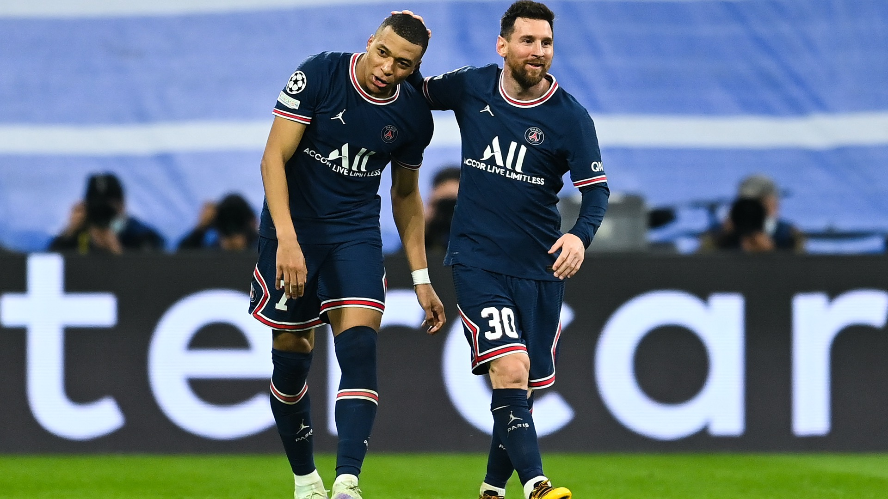
The Finisher's Signature
A Data-Driven Analysis of Messi vs. Mbappé

Slide 2
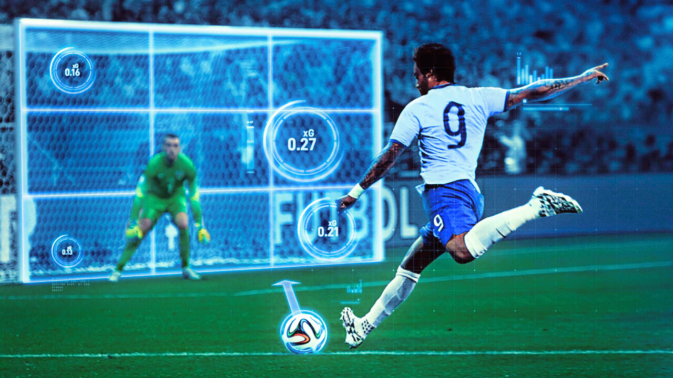

Finishing: More Than Just Goal Counts?
“Top scorers often both accumulate high xG and outperform it, reflecting clinical finishing.”
David Copeland-Smith, Founder Beast Mode Soccer

Slide 3
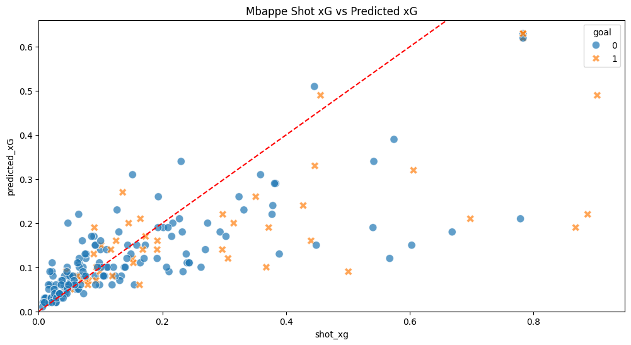
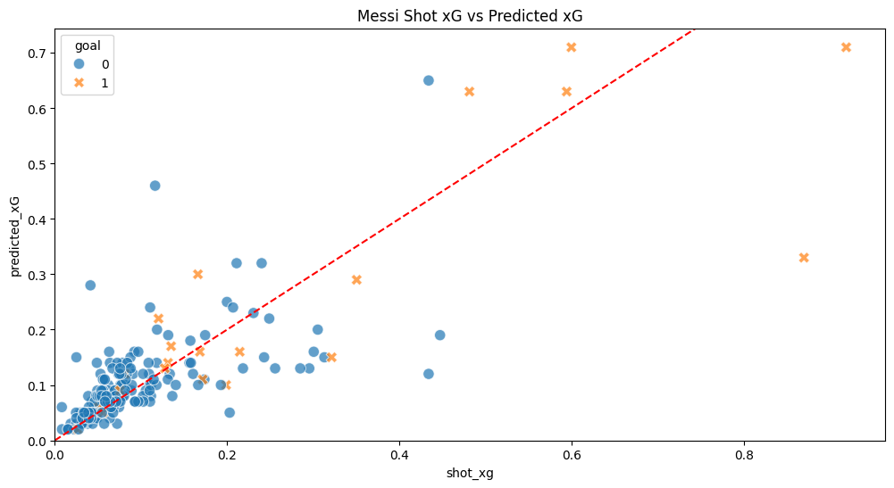

Two Distinct Finishing Signatures

Slide 4
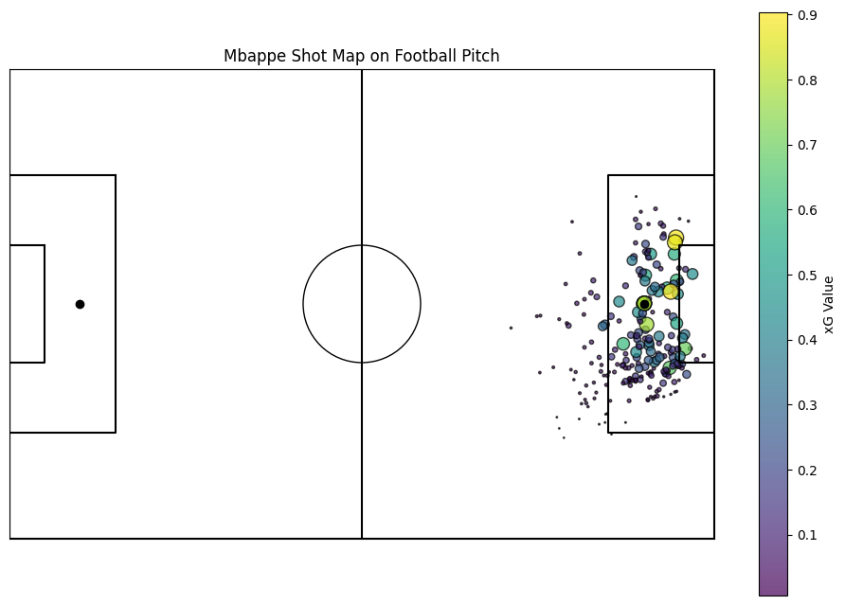
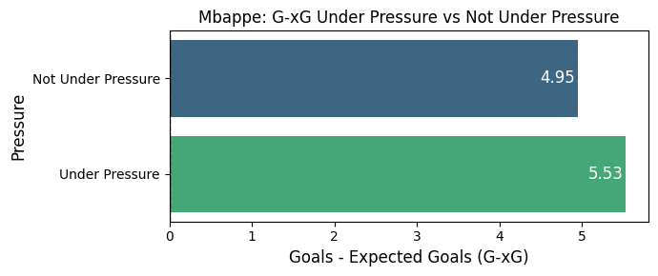

Mbappé: The Dynamic Finisher

Slide 5
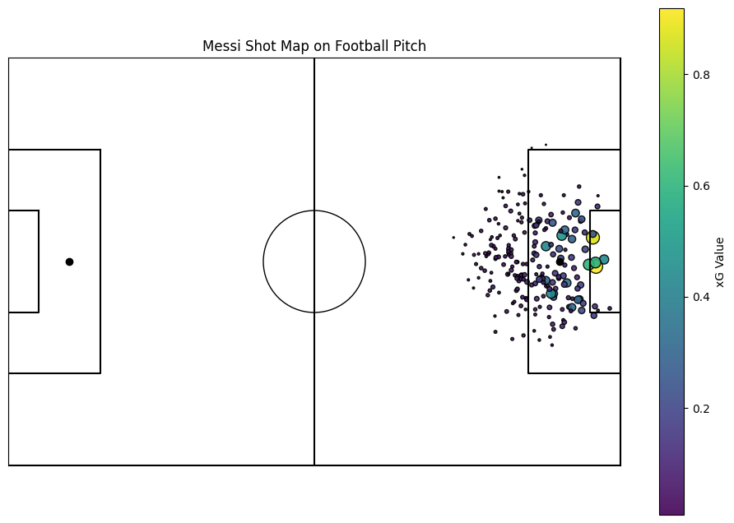
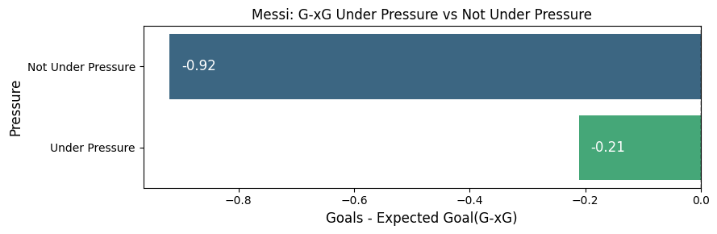

Messi: The Technical Maestro

Slide 6
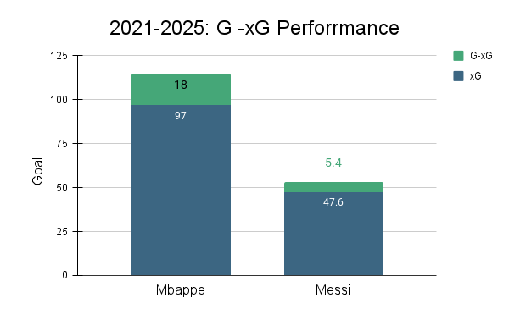

Verdict: Mbappe Performance is Greater

Slide 7

Conclusion
Both are Elite: Messi and Mbappe are proven overperformers of their xG.
Distinct Signatures: Mbappé excels at converting difficult chances, while Messi engineers perfect ones.
xG as a Diagnostic Tool: xG can be used not just to rate players, but to understand their unique finishing signature.

Slide 8
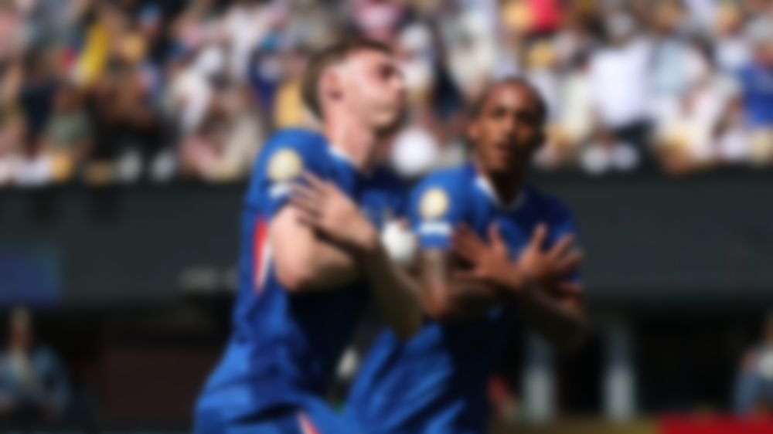
THANK YOU

